Slide 1
Case presentation
신장내과 PK A-5조
이도규

Slide 2
CC & Present illness
F/69y
Chief Complaint : 내원 2일 전 발생한 Generalized edema
Present illness
타원 검사상 Serum Albumin 1.7g/dL, U/A Protein 4+ 소견으로 Nephrrotic Syndrome 의심 하 정밀 평가 및 치료 위해 본원 응급실 통해 신장내과 입원
일주일 전 기저 체중 71kg에서 내원 당일 79.5kg으로 약 8.5kg의 급격한 체중 증가

Slide 3
Past History
Family history
N-S
Social history
Smoking (-)
Alcohol (-)
Past history & Operation history
Thyroiditis
Adrenal Insufficiency
Lung nodule (LUL) (2023.10)
Medication
NSAIDs 2주간 복용, 10일 전 마지막 복용

Slide 4
ROS & P/E (26.06.08)
ROS
General
Body weight gain(+8.5kg within 2 days)
Both leg pitting edema
Urinary
Decreased urine output
Respiratory
Dyspnea(mMRC grade 2)
Gastrointestinal
Nausea/vomiting/diarrhea : (-/-/-)
P/E
BP : 140/90mmHG
PR : 118회/min
RR : 19회/min
BT : 36.3
SPO2 : 99%

Slide 5
Initial laboratory findings(06.08)
검사명 | 결과 | 참고치 | 단위
BUN | 17.1 | 6~26 | mg/dL
Creatinine | 0.73 | 0.4~1.2 | mg/dL
Cystatin C | 0.88 |  | mg/L
GFR(CKD-EPI) | 84 |  | mL/min/1.73m^2
검사명 | 결과 | 참고치 | 단위
Urine Protein(24hr) | 12973 | 40~150 | mg/day
UPCR | 1745.71 | 15 | mg/mmol
UACR | 384.1 | 3 | mg/mmol
AST | 30 | 0~40 | U/L
ALT | 14 | 0~40 | U/L
ALP | 85 | 35~104 | U/L
T.Bilirubin | 0.18 | 0.1~1.2 | mg/dL
T.Protein | 4.82 | 6.0~8.0 | g/dL
Albumin | 2 | 3.3~5.2 | g/dL
PT INR | 1 | 0.88~1.12
Total Cholesterol | 490 | 0~200 | mg/dL

Slide 6
Diagnostic plan
Kidney related Factor
RFT f/u
Serology(Anti-PLA2R IgG, Anti-GBM Ab)
Kidney Biopsy
2. Heart related factor
TTE
3. Liver related Factor
Lab f/u : T. Bilirubin, AST, ALT, HBV, HCV, PT INR
Abdominal CT

Slide 7
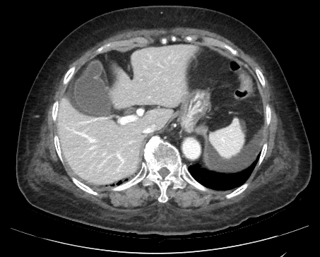
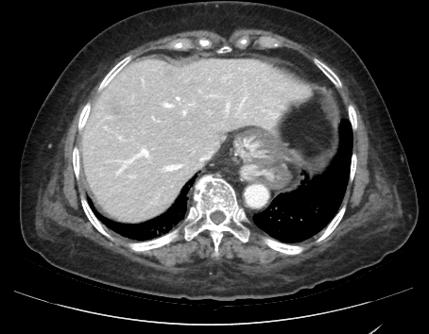
Abodminal CT(26.06.09)
GB hydrops
Duodenum and jejunal edema
No cirrhotic change

Slide 8
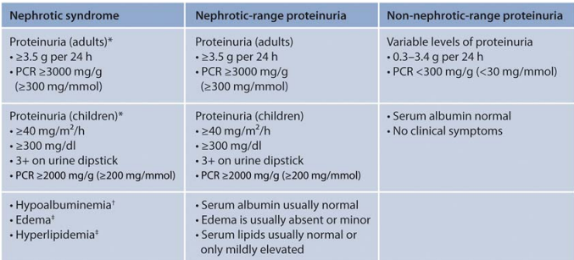
Assessment
Neprhotic Syndrome
Proteinuira
13g/day
UPCR 1745mg/mmol
Hypoalbuminemia
2g/dL
Edema
Hyperlipidemia
KDIGO 2021 Glomerular disease guideline

Slide 9
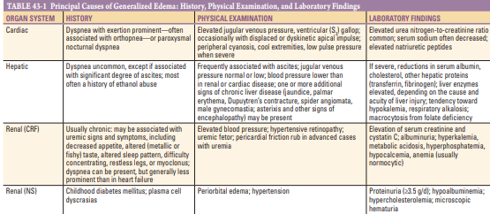
Assessment
Cardiac
TTE
Normal LV/RV systolic function
LVEF 65%
Hepatic
Normal Liver function
No sign of cirrhotic change
Renal
Normal BUN, Cr, eGFR, Cystatin C

Slide 10
Assessment
R/O MCD
Clinical Feature : Abrupt onset of edema
Massive Proteinuria : 13g/day
Mixed type Proteinuria : uPEP에서 Albumin fraction observed predominantly
Medication : NSAIDs 2주 복용, 10일 전 중단
R/O MGN
Hypercholesterolemia
Serology : Anti-PLA2R Ab(-), ANA(-), HBV(-), HIV(-)
Lung nodule : no evidence of Malignancy

Slide 11
Therapeutic plan
Supportive Management
Edema
Furosemide IV 40mg bid -> Furosemide tab 120mg bid
Diet : 신증후식 2000
Proteinuria
Losartan tab 25mg QD
BP 90/60, 일시 중단
Hyperlipidemia
Pitvastatin tab 2mg QD

Slide 12
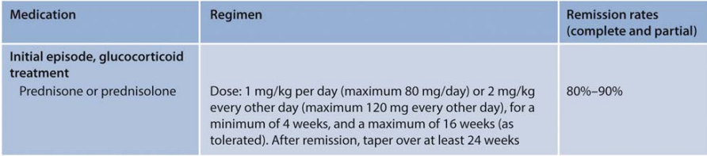
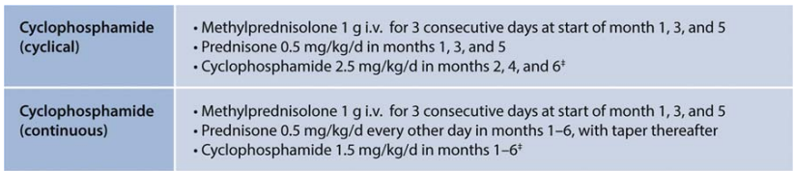
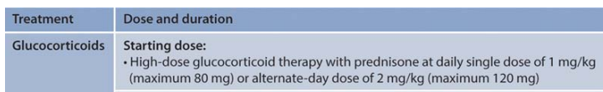
Therapeutic plan
KDIGO 2021 Glomerular disease guideline
MCD
Membranous nephropathy
FSGS

Slide 13
Therapeutic plan
Immunosuppressive Therapy for Nephrotic Syndrome
High-dose Glucocorticoid initiation (Prednisolone 70mg QD PO)
: 신생검 후 조직학적 확진 전 선제적 치료
DPP-4 inhibitor 5mg QD PO : 기저 당뇨 전단계(HbA1c 6.12%), 고용량 스테로이드 투여에 따른 당뇨 위험 관리 위해 선제적 처방

Slide 14
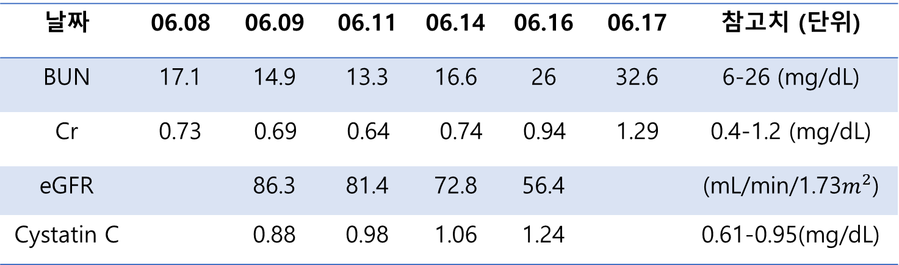
Progression note
RFT f/u
날짜 | 06.08 | 06.09 | 06.11 | 06.14 | 06.16 | 06.17 | 참고치 (단위)
BUN | 17.1 | 14.9 | 13.3 | 16.6 | 26 | 32.6 | 6-26 (mg/dL)
Cr | 0.73 | 0.69 | 0.64 | 0.74 | 0.94 | 1.29 | 0.4-1.2 (mg/dL)
eGFR |  | 86.3 | 81.4 | 72.8 | 56.4 |  | (mL/min/1.73$m^{2}$)
Cystatin C |  | 0.88 | 0.98 | 1.06 | 1.24 |  | 0.61-0.95(mg/dL)
날짜 | 06.08 | 06.09 | 06.13 | 06.15 | 06.16 | 06.17
Urine Protein | 4+ | 3+ | 4+ | 4+ | 4+ | 3+

Slide 15
Progression note
약제 변경
6/8
Furosemide 80mg IV
6/14
Furosemide 240mgPO
6/16
Furosemide 160mg PO + 80mg IV
ARB d/c
Prednisolone 70mg PO 추가
6/17 ~ : Furosemide 240mg PO
6/19 : Furosemide 160mg PO + Cyclosporine100mg
B/W f/u
날짜 | 06.08 | 06.09 | 06.15 | 06.16 | 06.17 | 06.18
체중 (kg) | 79.4 | 78.8 | 75.8 | 77.3 | 78.8 | 79.05

